Slide 1
Computer Networks
Application Layer
Adrian Sergiu DARABANT
Lecture 4

Slide 2

The Application Layer
All People Seem To Need Data Processing

Slide 3
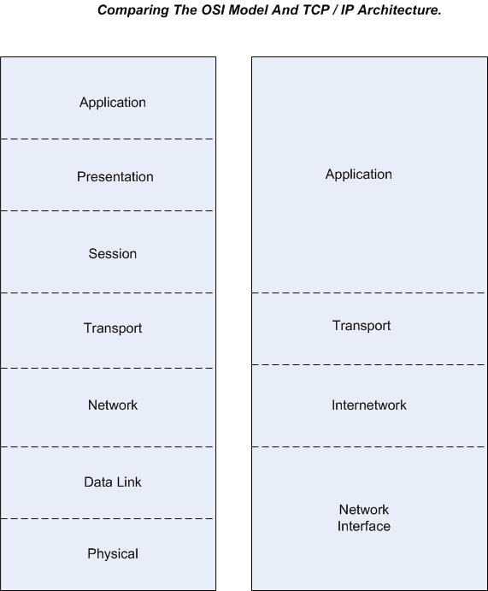
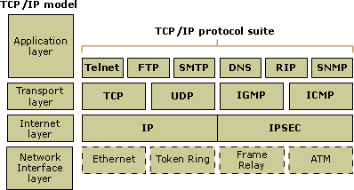
OSI vs TCP/IP Model

Slide 4
Application Layer Protocols
Defines :
  the types of messages exchanged, e.g., request messages and response messages
  the syntax of the various message types, i.e., the fields in the message and how the fields are delineated
  the semantics of the fields, i.e., the meaning of the information in the fields
  rules for determining when and how a process sends messages and responds to messages

Slide 5
The Client-Server Paradigm
Introduced by the communication architecture:
  Service Provider - Server
  Service Consumer – Client
A host can implement both sides of a service : client and server !

Slide 6
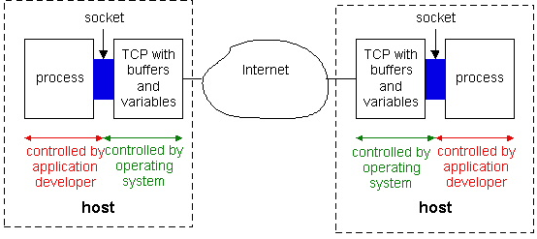
Communicating Processes

Slide 7
TCP/IP Communication
Hosts identified by IP Addresses (unique)
Applications on each host are identified by ports (0-65535)
Some of the available ports are well-known and assign to popular applications: ftp, http, dns, telnet, ssh, etc - rfc1700

Slide 8

TCP/IP Peer to peer communication
HTTP
63.78.171.45
Port: 80
193.231.20.34
Port: 1563
IPAddress + Port:
Identify communicating applications
on the source and destination machines

Slide 9
Application Level Protocols
DNS
SMTP
FTP
HTTP
TELNET, SSH
IMAP, POP3
FINGER, etc

Slide 10
The DNS Protocol
In the TCP/IP world each machine is uniquely identified by its IP Address.
IPAddress – 4 bytes = 32 bits
Numbers are hard to remember, names are easier.
Each machine is assigned a name in a tree-like structure.

Slide 11
DNS as a service
Domain Names (FQDN) or URLs are used by users – www.google.com
IP Address needed by programs – 66.249.93.104
The DNS Service Provides IP Name Resolution
DNS is a distributed database of Domain Names and their corresponding IP Addresses
RFC 1034, 1035

Slide 12
Domain Naming System
A hierarchical naming system used to give each server on the Internet a unique name.
www.google.com (URL or FQDN) HostName.Domain.TLD
HostName and the Domain Name = Fully Qualified Domain Name (FQDN)
Initial Implementation: hosts file

Slide 13
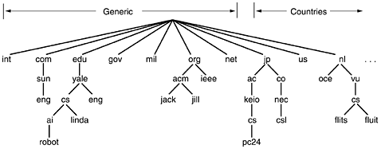
The DNS Namespace
Robot.ai.cs.yale.edu

Slide 14
Sources of Domain Names
ICANN (Internet Corporation For Assigned Names and Numbers) Oversees the Domain Name Registration Process (www.icann.org)
  Shared Database of Domain Names (Master Database)
  Maintained under Contract by Network Solutions (originally InterNIC)
Domain registrars- keep things organized
  Network Solutions, America Online, register.com, Tucows.com, RNC.RO
  Complete List of Registrars:
    http://www.icann.org/registrars/accredited-list.html

Slide 15
Registering a Domain Name
Contact a Domain Register
Choose a Unique Domain Name http://www.rnc.ro/ or other Register!
To See Who Currently Owns a Name http://www.rnc.ro (Whois Query) or whois(Unix)
Register the Domain Name
  $5-35 a year
  You need the FQDN’s Names and IP Addresses of (2) Two DNS Servers That Store DNS Information for Your Domain

Slide 16
Whois – ubbcluj.ro
[Querying whois.rotld.ro]
[whois.rotld.ro]
% whois.rotld.ro :
% Rights restricted by copyright.
% Este INTERZISA folosirea datelor de pe acest server in oricare
% alt scop decat operarea retelei. In special este INTERZISA
% folosirea lor in scopuri publicitare.
%
domain-name: ubbcluj.ro
description: BABES-BOLYAI UNIVERSITY
description: 1, M.Kogalniceanu, Cluj-Napoca
description: Phone: 40-64-194315, int. 204
description: Fax: 40-64-191906
admin-contact: GC106-ROTLD
technical-contact: IP75-ROTLD
zone-contact: CL143-ROTLD
nameserver: Zeus.UBBCluj.Ro 193.231.18.18
nameserver: Ns2.UBBCluj.Ro 193.231.20.1
nameserver: Ns3.UBBCluj.Ro 193.231.18.20
info: object maintained by ro.rnc local registry
notify: domain-admin@listserv.rnc.ro
object-maintained-by: ROTLD-MNT
mnt-lower: ROTLD-MNT
updated: hostmaster@rnc.ro 20010109
updated: hostmaster@rnc.ro 20010610
updated: hostmaster-cmircea@rotld.ro 20011126
updated: hostmaster-cmircea@rotld.ro 20011126
updated: hostmaster-cmircea@rotld.ro 20020320
updated: hostmaster-cmircea@rotld.ro 20020926
updated: danp@rnc.ro 20031003
source: ROTLD
person: Gabriel Ciplea
address: Mihail Kogalniceanu, Nr. 1
address: Cluj-Napoca, Romania
phone: +40 264 405 333
fax-no: +40 264 591 906
e-mail: tchiplea@ubbcluj.ro
nic-hdl: GC106-ROTLD

Slide 17
Whois-2
info:object maintained by ro.rnc local registry
notify: domain-admin@listserv.rnc.ro
object-maintained-by: ROTLD-MNT
updated:hostmaster-cmircea@rotld.ro 20020926
source: ROTLD
person: Ioan Ploscariu
address: Mihail Kogalniceanu, Nr. 1
address: Cluj-Napoca, Romania
phone: +40 264 405 344
fax-no: +40 264 191 906
e-mail: john@ubbcluj.ro
nic-hdl: IP75-ROTLD
info: object maintained by ro.rnc local registry
notify: domain-admin@listserv.rnc.ro
object-maintained-by: ROTLD-MNT
updated: hostmaster-cmircea@rotld.ro 20020926
source: ROTLD
person: Cristian Leonte
address: Mihail Kogalniceanu, Nr. 1
address: Cluj-Napoca, Romania
phone: +40 264 405 333
fax-no: +40 264 591 906
e-mail: romb@ubbcluj.ro
nic-hdl: CL143-ROTLD
info: object maintained by ro.rnc local registry
notify: domain-admin@listserv.rnc.ro
object-maintained-by: ROTLD-MNT
updated: danp@rnc.ro 20031003
source: ROTLD

Slide 18
DNS Software
Resolver
  Built into Client TCP/IP Software
  Ask Designated Name Server for IP Address When Client Enters FQDN (URL)
Name Server
  DNS Server (Available with Most OS’s)
  Retrieves IP Addresses for Clients
  Supplies IP Address to other Name Servers
  Provided by the Internet, ISP, or at the client.

Slide 19
DNS Software
Application Level
DNS Server
APP1
API gethostbyXXXX
System Functions
Binary DNS protocol
Resolver

Slide 20
DNS System
Originally one single central huge table. (hosts file) /etc/hosts
Hierarchical structure:
  Root DNS servers (serving .com .org .net…)
  DNS servers – serve domain queries.
DNS Servers
  Primary/Master – Authoritative on a zone (ubbcluj.ro)
  Secondary/Slaves – Temporarily Authoritative
  Forwarders/Caching DNS – no local database
Types of queries:
  Recursive queries
  Non-recursive (iterative) queries

Slide 21
DNS Design Goals
Creation Of A Global, Scalable, Consistent Name Space
Local Control Over Local Resources
Distributed Design To Avoid Bottlenecks
Application Universality
Multiple Underlying Protocol Support
Hardware Universality

Slide 22
DNS – Non Recursive & Caching
Connect at www.yahoo.com
Ask the Root Server for the .com ( a.gtld-servers.net )
a.gtld-servers.net asks the DNS server of the yahoo.com (ns1.yahoo.com)
ns1.yahoo.com determines that www.yahoo.com => is an alias for www.yahoo.akadns.net
Response gets back to the client www.yahoo.akadns.net

Slide 23
DNS Recursive & caching
Connect at www.yahoo.com
Ask Local Server(LS) for the www.yahoo.com
(LS)
  www.yahoo.com – cached 216.109.118.68
  Or asks Root Server for the .com
(LS) asks a.gtld-servers.net who is the DNS server for yahoo.com => ns1.yahoo.com
Ask ns1.yahoo.com who is www.yahoo.com => is alias for www.yahoo.akadns.net
Ask ns1.yahoo.com who is www.yahoo.akadns.net =>216.109.118.68

Slide 24
How DNS Works (The Two Key Functions)
Root Level DNS Server
TLD – COM DNS Server
Google DNS Server
FQDN
IP Address
IP Address
Client
www.google.com

Slide 25
DNS Example
DNS at Work example
Try this applet and check the DNS functioning.

Slide 26
Configuring DNS
DNS
  Information Stored in a Zone File
  Text Files
  Information About One or More Domains
  S tatic (Manually Updated)
Dynamic DNS – see dyndns.org
  Same Process/Types on Information
  Each Computer Dynamically Updates Its Information
  RFC
  Windows Server, Netware, etc

Slide 27
Placing DNS Servers on Internet
Need Two Name Servers
Yours or ISP’s
Register with Name Register (Rnc.Ro)
  Create a Host Record for Each Name Server (Host Name and IP Address)
  Register Domain Names With the Host Names and IP Addresses of Name Servers

Slide 28
Root Servers and TLDs
Root-Level Servers
  Authoritative (A.ROOT-SERVERS.NET)
  Maintained by VeriSign (Network Solutions) under contract with ICANN
Duplicate (B-M.ROOT-SERVERS.NET)
  Maintained by other organizations and businesses around the world
  http://www.root-servers.org/

Slide 29
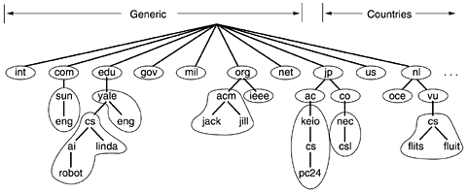
DNS Zone Division

Slide 30

Root Name Servers
a NSI Herndon, VA
c PSInet Herndon, VA
d U Maryland College Park, MD
g DISA Vienna, VA
h ARL Aberdeen, MD
j NSI (TBD) Herndon, VA
k RIPE London
i NORDUnet Stockholm
m WIDE Tokyo
e NASA Mt View, CA
f Internet Software C. Palo Alto, CA
13 root name servers worldwide
b USC-ISI Marina del Rey, CA
l ICANN Marina del Rey, CA

Slide 31
Resource records
RR=(Domain_name, Time_to_live, Class, Type, Value )
Type:
A – Name=hostname, Value = IP address
NS – Name =domain (ubbcluj.ro), Value=IP Addr of Authoritative NS
CNAME – Name=alias for canonical (real) name
MX – Name (implicit) domain, Value = name of mailserver for domain
Example:
www.ubbcluj.ro 1800 IN CNAME zeus.ubbcluj.ro
zeus.ubbcluj.ro 1800 IN A 193.226.40.33

Slide 32
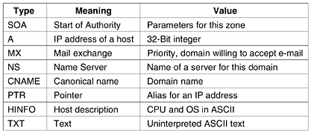
DNS Database-Record types

Slide 33
DNS Database
Linux BIND DNS implements it in a file, Windows in Registry:
utcluj.ro SOA hercule.utcluj.ro. root.hercule.utcluj.ro.
2004101451 ; serial no
36000 ; refresh
3600 ; update retry
2390400 ; expiry
360000 ; minimum or TTL
utcluj.ro NS ns.edu.ro.
utcluj.ro NS ns.roedu.net.
utcluj.ro NS ns-a.rnc.ro.
utcluj.ro NS hercule.utcluj.ro.
utcluj.ro MX 30 hercule.utcluj.ro.
www.utcluj.ro CNAME orion.cluj.roedu.net.
webmail.utcluj.ro CNAME bavaria.utcluj.ro.
ana.utcluj.ro A 192.129.4.93
apollo.utcluj.ro A 193.226.7.154
hercule.utcluj.ro A 193.226.5.33

Slide 34
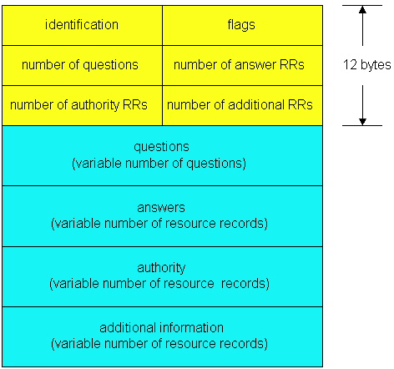
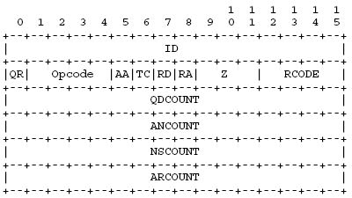
DNS Packet Structure

Slide 35
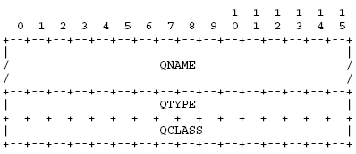
Query DNS Packet Structure
QName – host name or query data (www.cs.ubbcluj.ro)
QType- A, PTR, MX, NS, SOA, etc
QClass – the query class (type of adressing- IN=Internet)

Slide 36
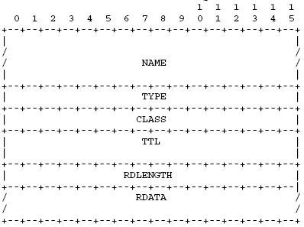
Answer - (RR) DNS Packet Structure
NAME – the domain name to which this RR pertains
TYPE – RR Type
TTL- Time to Live (cache)
RDLENGTH – length of the RDATA (answer)
RDATA – data. For an IN A query => 4 bytes address

Slide 37
The FTP Protocol
Allows exchanging files between two machines.
Text protocol
RFCs - [RFC 959].
It is designed to cope with different machine architectures.

Slide 38


Architecture
FTP
user
interface
FTP
client
file transfer
FTP
server
user
at host
local file
system
remote file
system
  client: side that initiates transfer (either to/from remote)
  server: remote host

Slide 39
Control and data connections
FTP uses 2 comm channels
  The control channel
  The data channel
FTP modes
  Active
  Passive

Slide 40
Ftp
TCP control connection
port 21
FTP client contacts FTP server at port 21, specifying TCP as transport protocol
Client obtains authorization over control connection
Client browses remote directory by sending commands over control connection.
When server receives a command for a file transfer, the server opens a TCP data connection to client
After transferring one file, server closes connection.
FTP
client
TCP data connection
port 20
FTP
server
Server opens a second TCP data connection to transfer another file.
Control connection: “out of band”
FTP server maintains “state”: current directory, earlier authentication

Slide 41
FTP commands
ftp> quote help
214-The following commands are recognized (* =>'s unimplemented):
CWD XCWD CDUP XCUP SMNT* QUIT PORT PASV
EPRT EPSV ALLO* RNFR RNTO DELE MDTM RMD
XRMD MKD XMKD PWD XPWD SIZE SYST HELP
NOOP FEAT OPTS AUTH* CCC* CONF* ENC* MIC*
PBSZ* PROT* TYPE STRU MODE RETR STOR STOU
APPE REST ABOR USER PASS ACCT* REIN* LIST

Slide 42
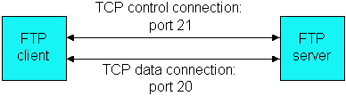
FTP Channels

Slide 43
Active connection
testbox1: {/home/p-t/slacker/public_html} % ftp -d testbox2 Connected to testbox2.slacksite.com. 220 testbox2.slacksite.com FTP server ready.
Name (testbox2:slacker): slacker
---> USER slacker
331 Password required for slacker.
Password: TmpPass –
--> PASS XXXX
230 User slacker logged in.
---> SYST 215 UNIX Type: L8
Remote system type is UNIX. Using binary mode to transfer files.
ftp> ls
ftp: setsockopt (ignored): Permission denied ---> PORT 192,168,150,80,14,178
200 PORT command successful.
---> LIST
150 Opening ASCII mode data connection for file list.
drwx------ 3 slacker users 104 Jul 27 01:45 public_html
226 Transfer complete.
ftp> quit
---> QUIT
221 Goodbye.

Slide 44
Passive connection
testbox1: {/home/p-t/slacker/public_html} % ftp -d testbox2
Connected to testbox2.slacksite.com.
220 testbox2.slacksite.com FTP server ready.
Name (testbox2:slacker): slacker
---> USER slacker
331 Password required for slacker.
Password: TmpPass
---> PASS XXXX
230 User slacker logged in.
---> SYST 215 UNIX Type: L8
Remote system type is UNIX. Using binary mode to transfer files.
ftp> passive Passive mode on.
ftp> ls
ftp: setsockopt (ignored): Permission denied
---> PASV
227 Entering Passive Mode (192,168,150,90,195,149).
---> LIST
150 Opening ASCII mode data connection for file list
drwx------ 3 slacker users 104 Jul 27 01:45 public_html
226 Transfer complete.
ftp> quit
---> QUIT
221 Goodbye.

Slide 45
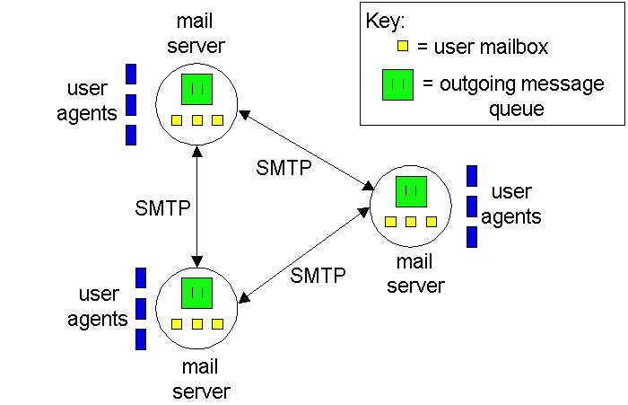
The SMTP Protocol

Slide 46
The SMTP protocol
Server port is 25
The protocol is text
Allows for offline message exchanging

Slide 47
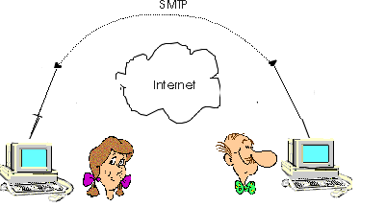
Mail system – Offline/Online ?

Slide 48
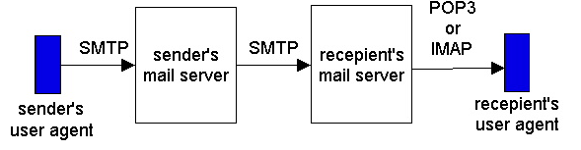
Offline Mail Sistem (Agents)

Slide 49
Mail system
SMTP – mail exchange protocol
Mail Reading
  POP3 Post Office Protocol
  IMAP Internet Mail Access Protocol

Slide 50
home05122 root]# telnet evolution.cs.ubbcluj.ro 25
Trying 193.226.40.136...
Connected to evolution.cs.ubbcluj.ro.
Escape character is '^]'.
220 evolution.cs.ubbcluj.ro ESMTP Sendmail 8.12.11/8.12.11; Fri, 5 Nov 2004 01:28:14 +0200
helo astral.ro
250 evolution.cs.ubbcluj.ro Hello Home05122.cluj.astral.ro [194.102.147.61], pleased to meet you
mail from: asergiu@yahoo.co.uk
250 2.1.0 asergiu@yahoo.co.uk... Sender ok
rcpt to:dadi@evolution.cs.ubbcluj.ro
250 2.1.5 dadi@evolution.cs.ubbcluj.ro... Recipient ok
data
354 Enter mail, end with "." on a line by itself
From:asergiu@yahoo.co.uk
To:dadi@evolution.cs.ubbcluij.ro
Subject: This is a teste message
Well just a test ...
See ya.
.
250 2.0.0 iA4NSEqa029960 Message accepted for delivery

Slide 51
The World Wide Web
HTML Language – to describe Web pages =>RFC1866 and RFC1942
HTTP protocol – to transmit web pages
The Uniform Resource Locator – to name Web pages
Hypertext – a way of describing documents and data that reference other documents/data.

Slide 52
HTTP Protocol
Allows exchange of HTML and Web data.
Works on TCP port 80 and is human readable.
Ex: Connect to www.cs.ubbcluj.ro
GET / HTTP/1.0 >
>
< HTTP/1.0 200 OK
< Date: Wed, 18 Sep 1996 20:18:59 GMT
< Server: Apache/1.0.0
< Content-type: text/html
< Content-length: 1579
< Last-modified: Mon, 22 Jul 1996 22:23:34 GMT
<
< HTML document

